Slide 1
NETWORKING FUNDAMENTALS CAPSTONE PROJECT
Godswill Archibong

Slide 2
introduction
Company Name: RICHKIM EMPIRE Parent Organization: Akamai Technologies (Capstone Scenario) Industry Focus: Cybersecurity Services For SOHO Clients
RICHKIM EMPIRE is a fictitious cybersecurity startup created as part of Akamai’s networking fundamentals capstone project. The goal of this project is to design, implement, and validate a secure and functional internal network suitable for a small office home office (SOHO) cybersecurity company.
This presentation outlines the network design decisions, implemented services, and validation steps used to demonstrate practical networking knowledge.

Slide 3
Business context
RICHKIM EMPIRE operates as a cybersecurity startup company delivering security services to SOHO clients
The organization consists of 8 employees, including:
Chief executive officer (CEO)
Operations/business manager
Technical staff (security & networking)
General administrative staff
The company maintains a public-facing web presence to showcase services and support client engagement

Slide 4
Network Requirements
Secure Internal Local Area Network (LAN)
Protect internal systems, staff devices, and shared resources
Reliable Internet Connectivity
Enable staff to access cloud services, threat intelligence platforms, and remote tools
Public Web Server Accessibility
Allow external users to access the company website via a public URL
Support for Shared Office Devices
Network printers and scanners available to designated staff roles
Scalable SOHO-Oriented Design
Simple, cost-effective architecture that can grow with the business

Slide 5
Internal Network Design Overview
Network type: small office local area network (LAN)
Connected devices:
2+ client pcs (demonstration)
4 network printers
1 network scanner
Internal switch
Edge router

Slide 6
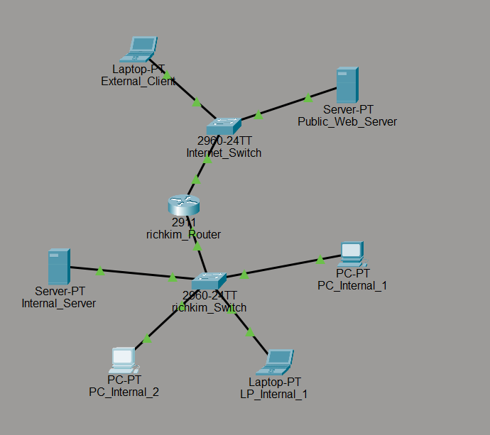
Physical & Logical Topology
Connectivity choices:
Wired Ethernet for stability and security
Star topology using a central switch
Cabling used:
Copper straight-through cables
Pcs → switch
Printers & scanner → switch
Switch → router (LAN interface)
Figure 1: Packet Tracer topology showing internal LAN devices connected to the switch and router.

Slide 7
IP Addressing & Network Services
IP addressing scheme
Implemented a private ipv4 network using the 192.168.20.0/24 address space
Assigned the router’s LAN interface as the default gateway (192.168.20.1) for all internal devices
Private addressing was chosen to protect internal systems and prevent direct exposure to the internet
Configured Network Services
DHCP: Configured on the router to automatically assign IP addresses, subnet masks, default gateways, and DNS settings to internal devices
DNS: Enabled name resolution to allow users to access internal services and the public website using human-readable URLs instead of IP addresses.

Slide 8
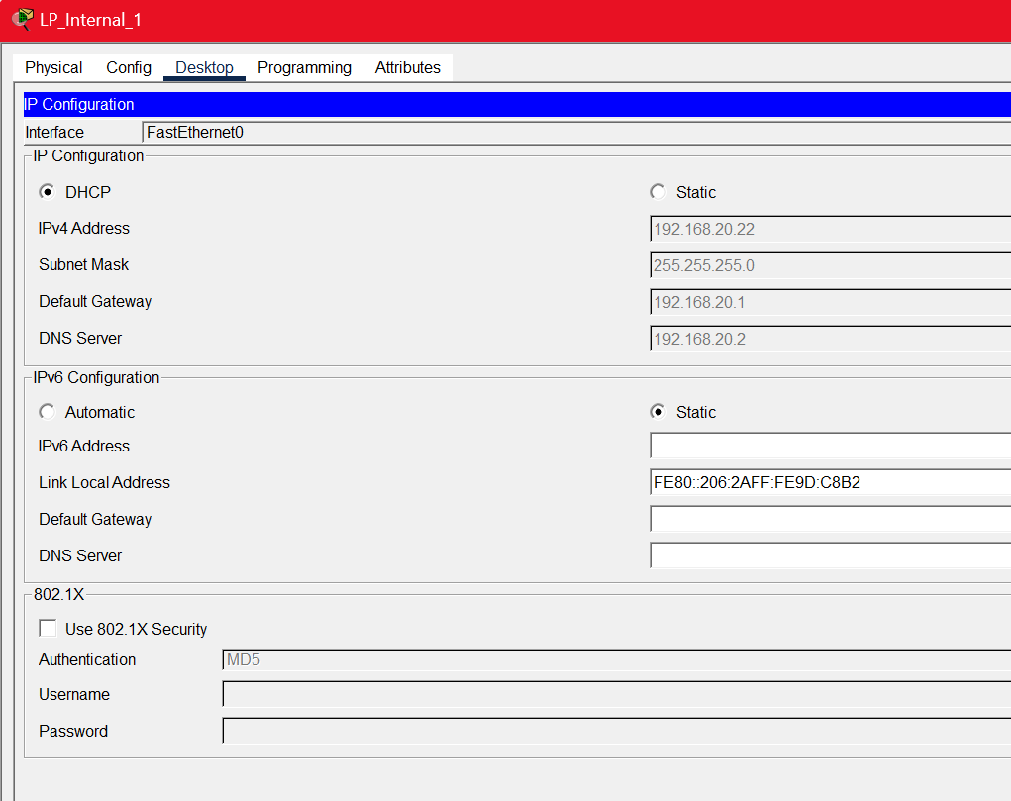
Figure 2: Dynamically assigned IP on an internal PC.

Slide 9
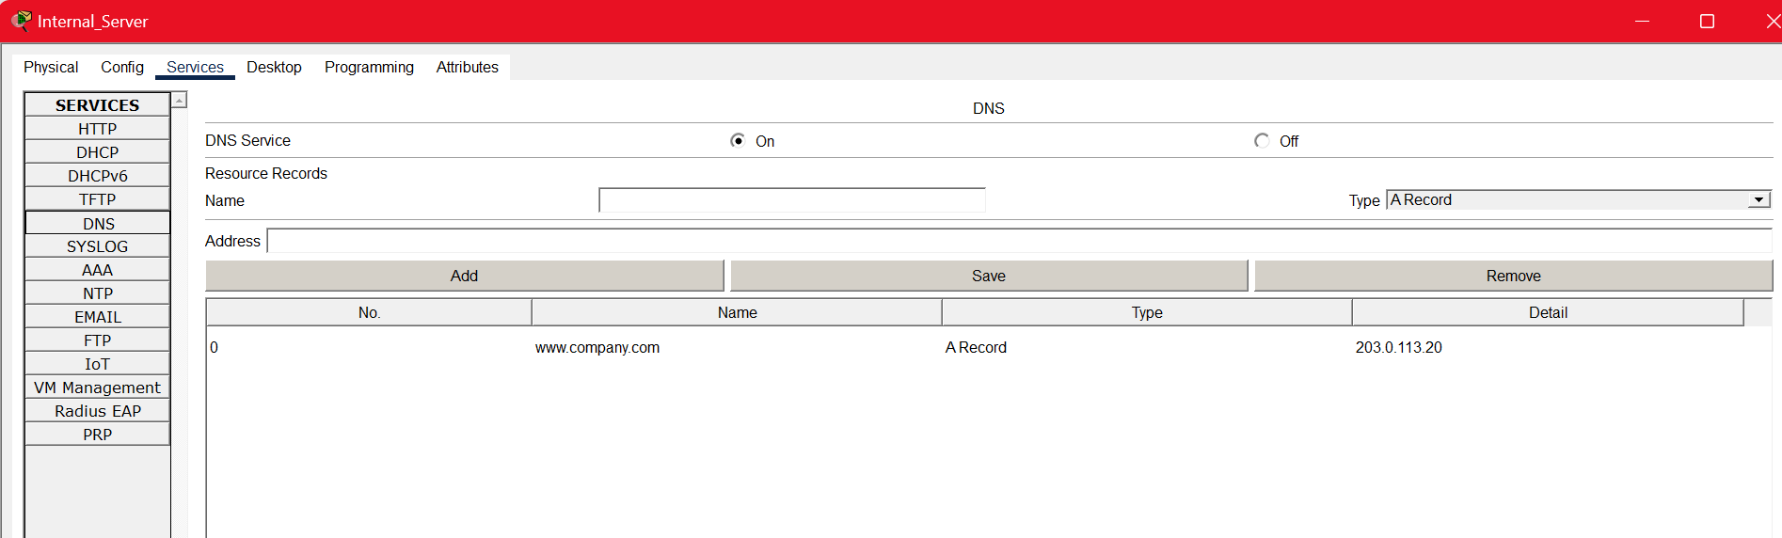
Public Web Server Configuration
To represent the company’s public-facing services, a web server was deployed as part of the network design. The server hosts the company website and is configured to be accessible from both internal LAN users and external internet users.
The web server is associated with the domain name www.company.com, allowing access via a URL rather than an IP address. This setup mirrors real-world business environments where customers interact with services through domain names. Proper routing and DNS configuration ensure seamless access from authorized networks.
Figure 3: Public server configuration

Slide 10
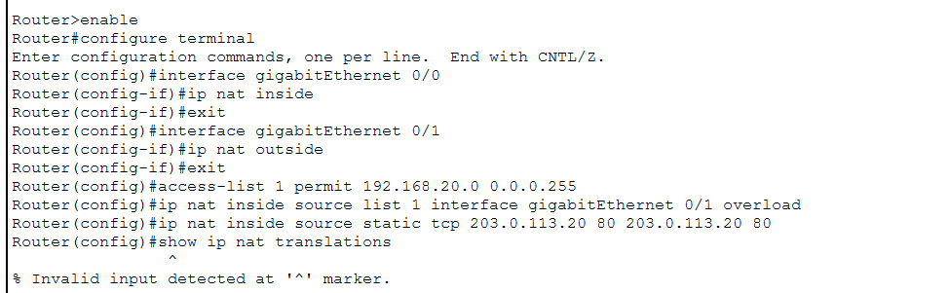
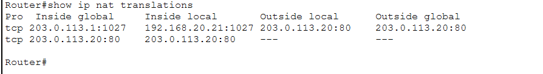
Internet Connectivity & NAT Implementation
Internet access for internal users is provided through an edge router connecting the LAN to the ISP network. To enable communication between private internal addresses and the public internet, network address translation (NAT overload / PAT) was implemented on the router.
Nat translates multiple private ip addresses into a single public-facing address, allowing internal users to browse the internet securely while hiding internal network details. This approach is cost-effective, widely used in SOHO environments, and aligns with basic cybersecurity best practices.
Figure 4: Router CLI showing NAT configuration

Slide 11
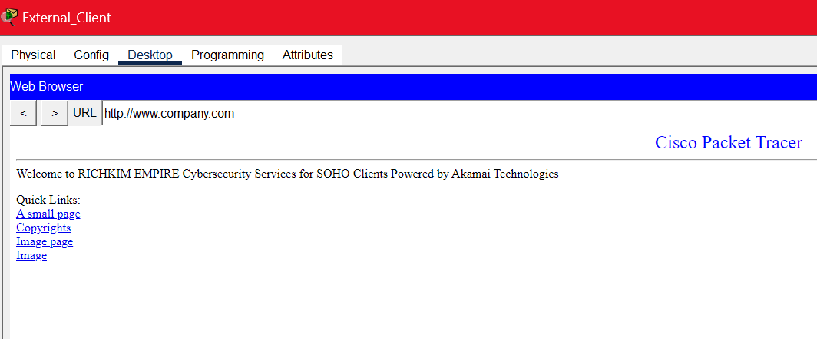
External Access & Public Website Validation
To validate external accessibility, an external client was configured outside the internal LAN to simulate an internet user. This client accesses the RICHKIM EMPIRE website using the public URL http://www.company.com.
Successful access confirms that routing, NAT, and DNS are functioning correctly and that the public web server is reachable from outside the organization. This step demonstrates that the network supports real-world customer interaction without exposing internal resources.
Figure 6: External client successfully loading the company website in a web browser

Slide 12
Conclusion & Key Takeaways
This capstone project demonstrated the practical design and implementation of a secure and functional network for RICHKIM EMPIRE, a SOHO-focused cybersecurity startup. The network was designed to meet real-world business needs while remaining cost-effective and scalable.
Key networking concepts were applied, including structured IP addressing, DHCP and DNS services, NAT for secure internet access, and the deployment of a public web server. Each component was configured, tested, and validated to ensure reliable internal communication and controlled external access.
Key takeaway: the designed network is scalable, secure, and aligned with real-world SOHO cybersecurity best practices.
The company is now well-positioned to deliver reliable cybersecurity services supported by a strong networking foundation.

